Slide 1
Developing a nomogram model for predicting non-obstructive azoospermia using machine learning techniques
Presented by Jordan Clemsen

Slide 2
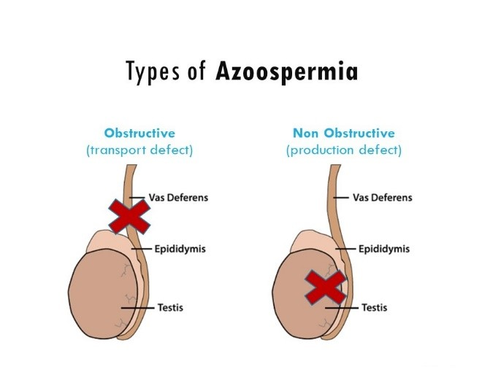
Azoospermia
Obstructive AS is cause by a blockage preventing spermiogenesis
NOA
- Hormone adjustments
- Genetic conditions
- Toxins

Slide 3
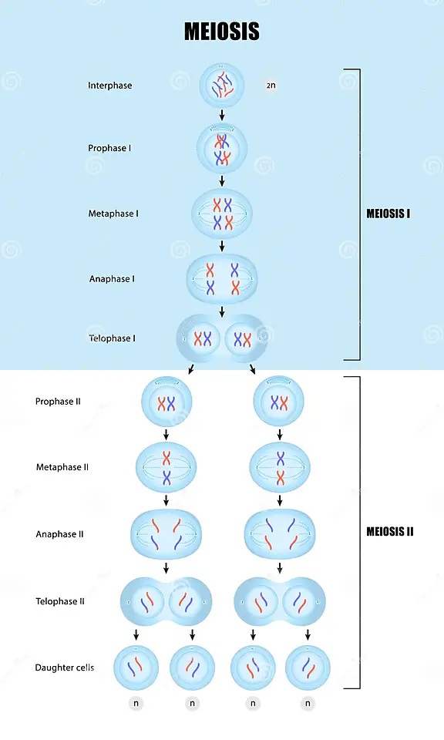

Slide 4
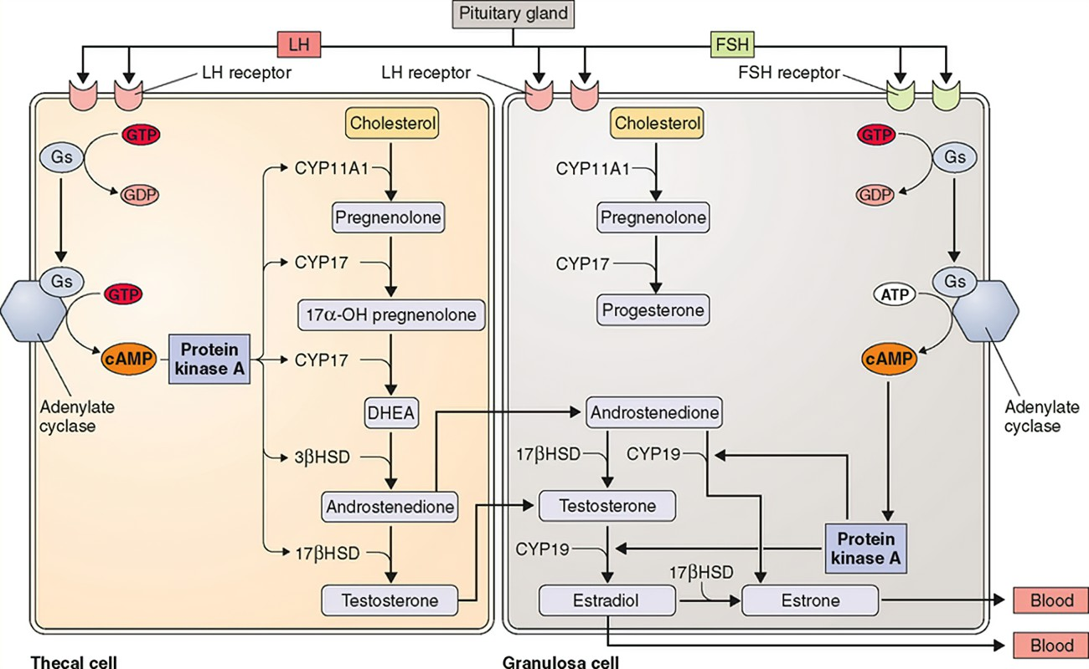

Slide 5
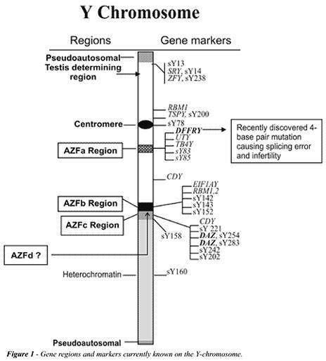
AZF
AZF is located on the long arm of the Y chromosome
AZF contains multiple genes that act as transcription factors
The genes SRY, USP9Y, CDY, AZFc and more are expressed in the brain
Sperm can be produced with a Y chromosome

Slide 6
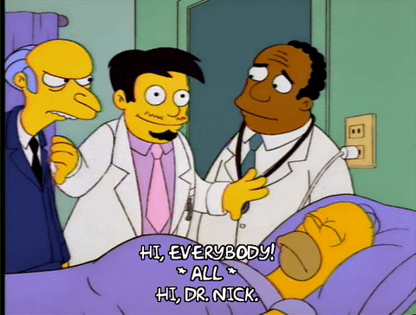
Introduction
• Azoospermia is a leading cause of male infertility, categorized into obstructive (OA) and non-obstructive (NOA).
• Distinguishing OA from NOA is critical for treatment planning.
• Current diagnostics are invasive and not always available in resource-limited settings.
• Objective -> Develop a non-invasive, machine learning-based prediction model.

Slide 7
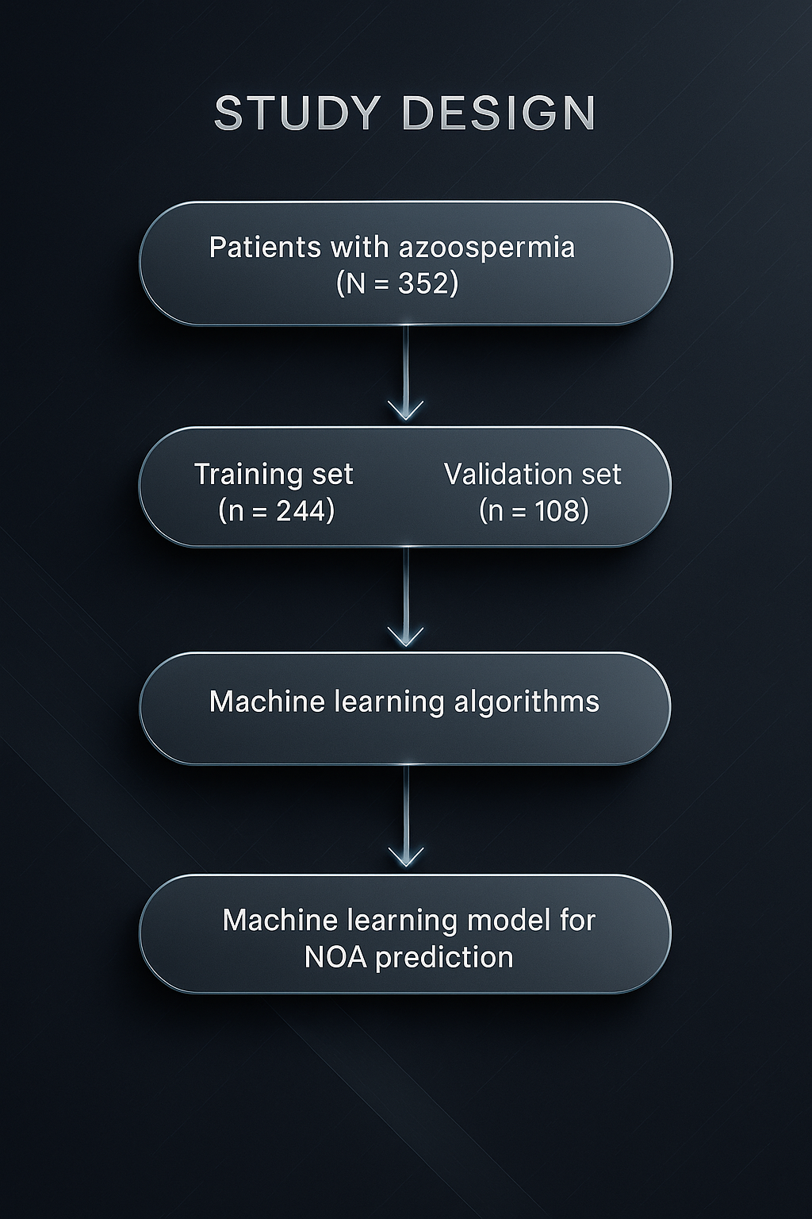
Study Design
• Retrospective study of 352 azoospermic patients (200 NOA, 152 OA).
Shapiro-Wilk test and Levene’s test used to assess distribution
• Data split into training (244) and validation (108) sets.
• Parameters collected: hormone levels, testicular volume, semen pH, etc.\

Slide 8
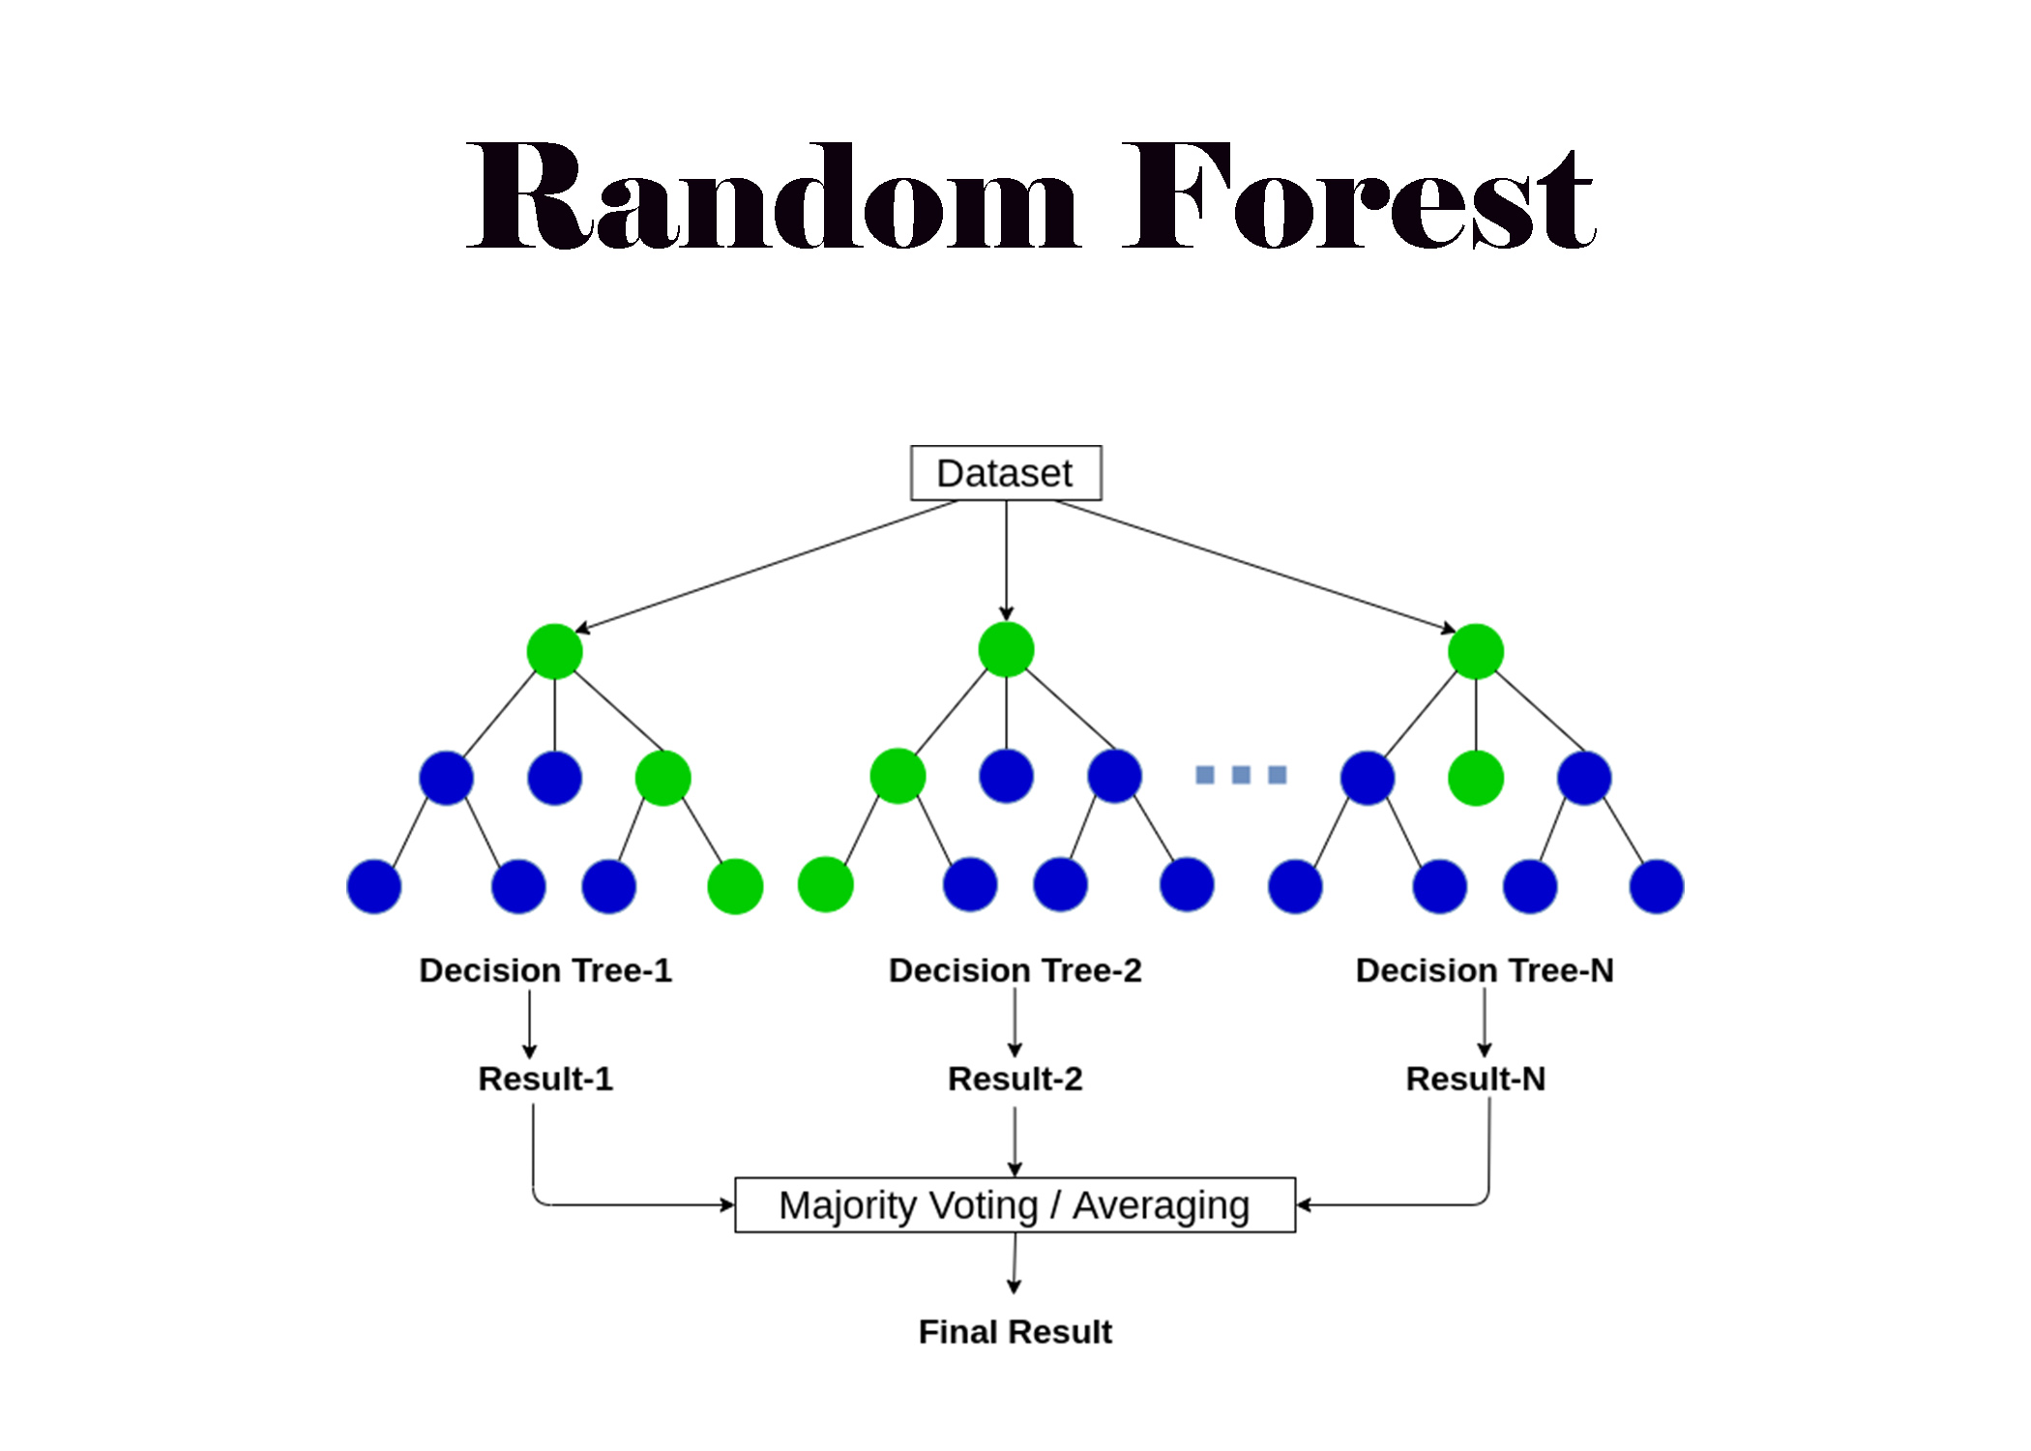
Machine Learning Methods
• Applied 9 machine learning algorithms:
- Random Forest, GBDT, XGBoost, LightGBM, Naive Bayes, SVM, Logistic Regression, Decision Trees, Neural Networks
• Best performance: Gradient Boosting Decision Trees (AUC = 0.974)

Slide 9
What are you thoughts on the techniques chosen?

Slide 10
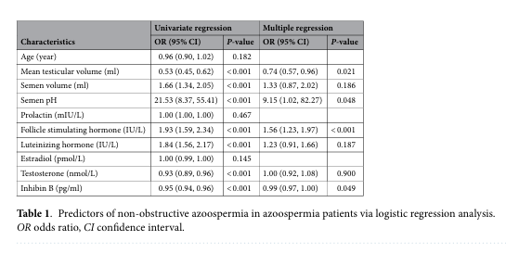
Key Predictors
• Positively correlated with NOA:
- Follicle-stimulating hormone (FSH)
- Semen pH
• Negatively correlated with NOA:
- Mean testicular volume (MTV)
- Inhibin B (INHB)

Slide 11
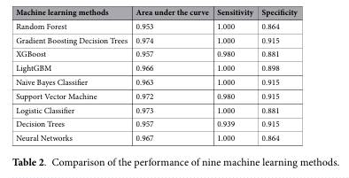
Nomogram Model & Performance
• Built using FSH, INHB, MTV, and pH.
• Training AUC: 0.984 | Validation AUC: 0.976
• Strong calibration and decision curve analysis support clinical utility.

Slide 12
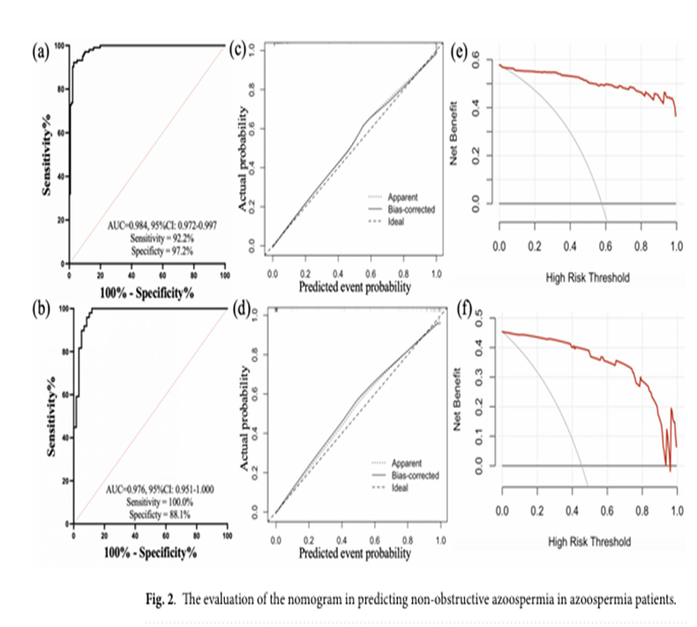

Slide 13
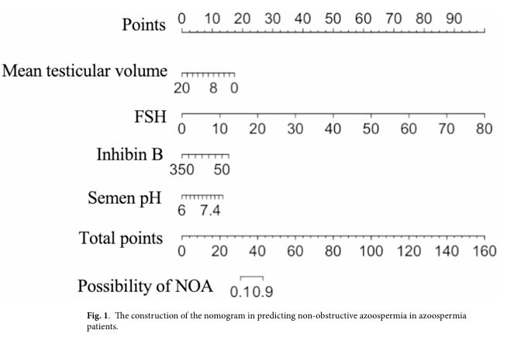
Conclusion
• Machine learning can accurately predict NOA using non-invasive biomarkers.
• The model helps avoid unnecessary biopsies, especially in low-resource settings.
• Future work: external validation and development of an online calculator.

Slide 14
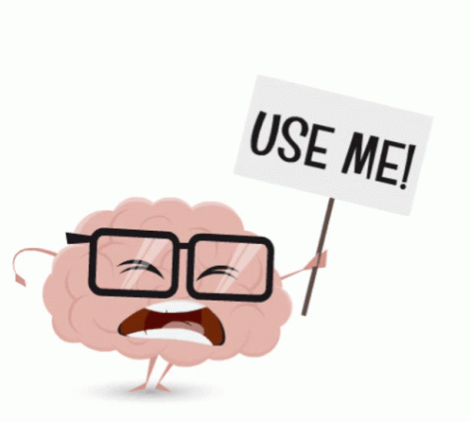
Critiques
Lack of external validation
Which genes influenced AZF
Comorbidities
Ethnic/racial differences in biomarker thresholds
Absence of imaging enhancements and real-time applications
…Neuroimaging

Slide 15
How would you build upon this study?

Slide 16
Refrences
Brain GIF - Tenor GIF Keyboard—Bring Personality To Your Conversations | Say more with Tenor. (n.d.). Tenor. Retrieved May 13, 2025, from https://tenor.com/view/brain-gif-18521472
Developing a nomogram model for predicting non-obstructive azoospermia using machine learning techniques | Scientific Reports. (n.d.). Retrieved May 13, 2025, from https://www.nature.com/articles/s41598-025-88387-5
Figure 1: Schematic of AZF regions on the human sex Y chromosome [1]. (n.d.). ResearchGate. Retrieved May 11, 2025, from https://www.researchgate.net/figure/Schematic-of-AZF-regions-on-the-human-sex-Y-chromosome-1_fig1_347074248
GIPHY - Be Animated. (n.d.). GIPHY. Retrieved May 13, 2025, from https://giphy.com
Manoa, U. of H. at. (n.d.). Male mice without any Y chromosome genes can father offspring after assisted reproduction. Retrieved May 11, 2025, from https://phys.org/news/2016-01-male-mice-chromosome-genes-father.html
Mānoa: Male mice without Y chromosome genes can father offspring after assisted reproduction | University of Hawaii News. (n.d.). Retrieved May 11, 2025, from https://www.hawaii.edu/news/article.php?aId=7652
Two genes substitute for the mouse Y chromosome for spermatogenesis and reproduction | Science. (n.d.). Retrieved May 11, 2025, from https://www.science.org/doi/full/10.1126/science.aad1795?casa_token=ALdvSYPV6bIAAAAA%3A6R-ZFQurwiHouSC9qwT_DXy1p4kaf9iJKGjv3UrPeQ_baws-93vscXQ5sC8RayxRioJ4oN1E6FhuEbeK
Xiao, H., Ding, Y.-L., Wang, C., Yang, P., Chen, Q., He, H.-N., Yao, R., Huang, H.-L., Chen, X., Wang, M.-Y., Tang, S.-X., & Zhou, H.-L. (2025). Developing a nomogram model for predicting non-obstructive azoospermia using machine learning techniques. Scientific Reports, 15(1), 5468. https://doi.org/10.1038/s41598-025-88387-5
Yamauchi, Y., Riel, J. M., Ruthig, V. A., Ortega, E. A., Mitchell, M. J., & Ward, M. A. (2016). Two genes substitute for the mouse Y chromosome for spermatogenesis and reproduction. Science, 351(6272), 514–516. https://doi.org/10.1126/science.aad1795

